Slide 1
Check Your Thermal Exhaust Port: 10 Vulnerabilities Your Web App Probably Has Right Now

Slide 2
Agenda
Series of lightning talks
SQL Injection
Directory Traversal/Backtracking
Broken access control
Package vulnerabilities
Guids vs Ints
Container Vulnerabilities
JWT Stale Roles
Data Leaking
Clickjacking
Lack of WAF

Slide 3
Goals
Exposure to security vulnerabilities
Not just OWASP Top 10
Check yourself before you wreck yourself

Slide 4

Stuff I’ve Heard Clients Say

Slide 5

One problem

Slide 6

One problem

Slide 7
It’s the same with web apps
One vulnerability can take down an otherwise rock solid web application
There are hundreds of attack types
We’re just going to cover 10

Slide 8

SQL Injection

Slide 9
SQL Injection
What is it?
Allows attackers to execute queries against your database
Why should I care?
They can get at some or all of your data
They can change or delete some or all of your data

Slide 10
SQL Injection
How do I fix it?
Parameterize Queries

Slide 11
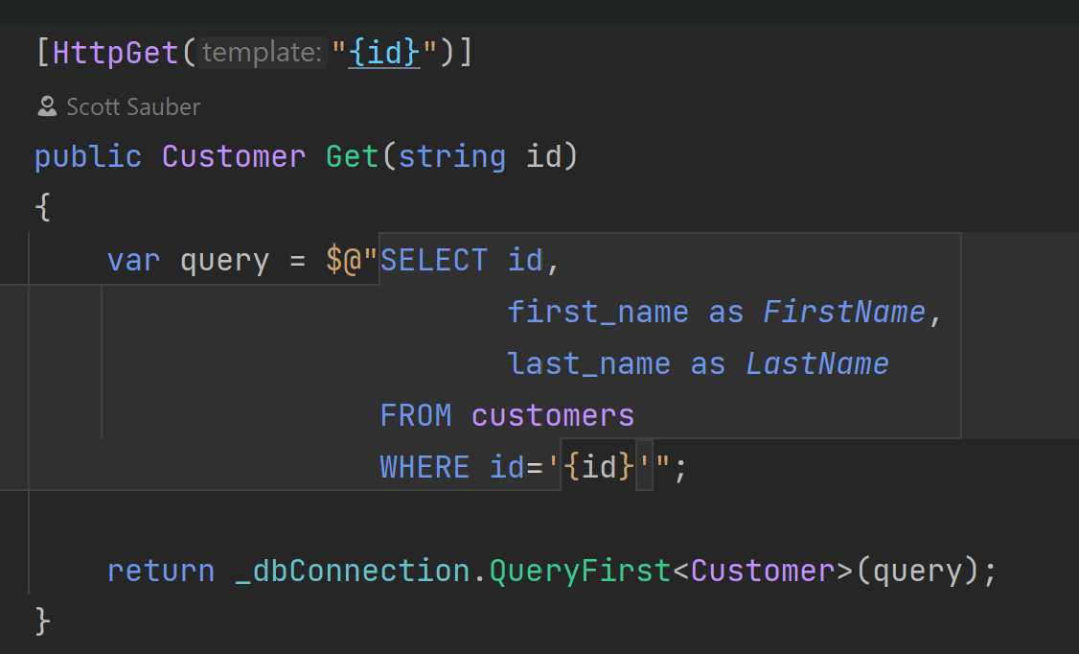
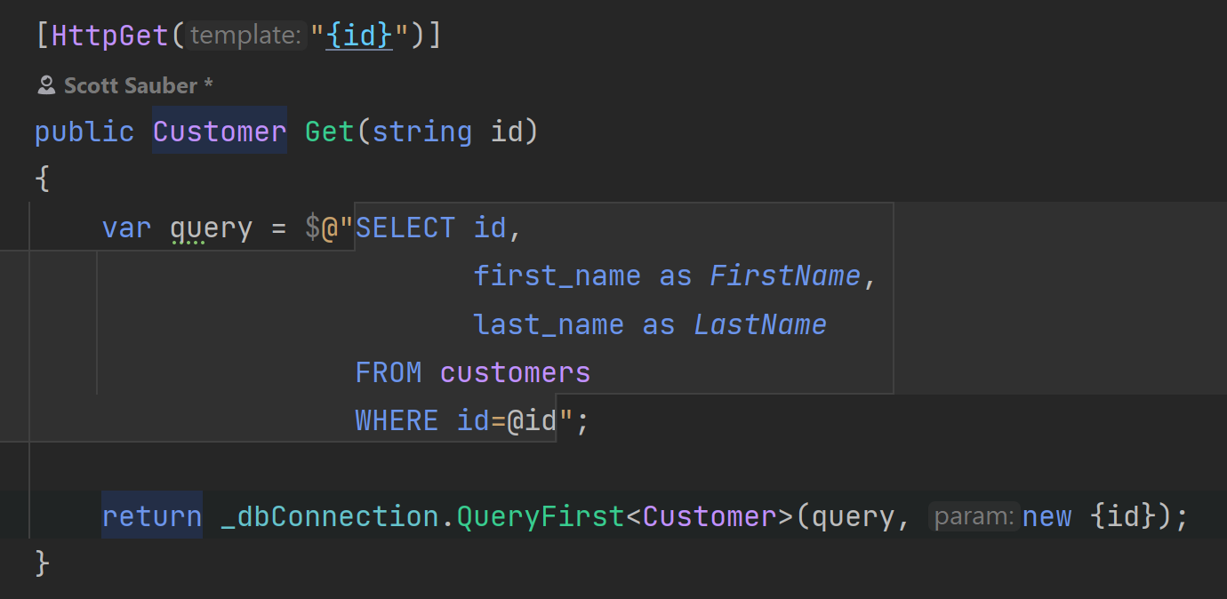
Vulnerable to SQL Injection
Not Vulnerable to SQL Injection

Slide 12
SQL Injection Demo
Notes:
- Demo working by passing in ID
- Demo still working ok with ID OR ‘1’ = ‘1
- Demo NOT working OK by moving ‘1’ = ‘1’ to beginning
- Demo working on by putting ;DROP TABLE customers bc the semi colon is saving you
- Demo NOT working by adding -- for SQL comment where it comments out the last semi colon

Slide 13

Directory Traversal (aka Backtracking)

Slide 14
Directory Traversal
What is it?
Allows attackers to access folders and files they shouldn’t have access to
Why should I care?
Exposes data, potentially sensitive data

Slide 15
Directory Traversal
How do I fix it?
Do not intake a path from a user
Perform authorization check on backend
One approach – file request based on GUID, path stored in database

Slide 16
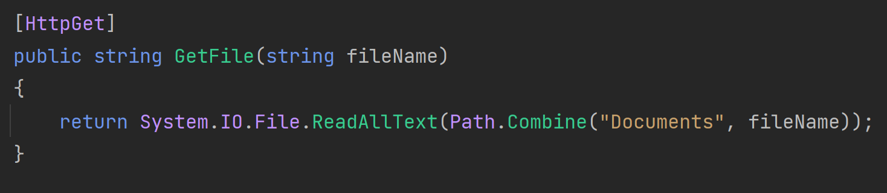
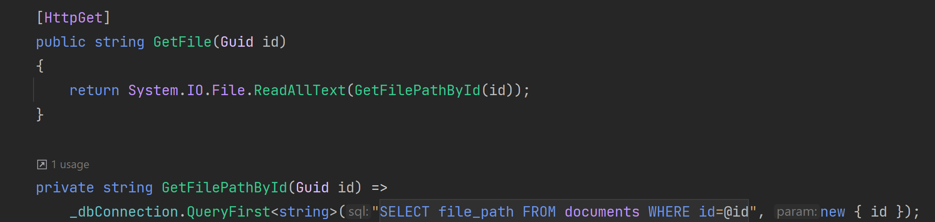
Vulnerable
Not Vulnerable

Slide 17
Directory Traversal Demo
Notes:
Get access to file
Dump appsettings.json file

Slide 18

Directory Overwriting

Slide 19
Directory Overwriting
What is it?
Allows attackers to overwrite files or folders they shouldn’t have access to
Why should I care?
Loses valid files or folders

Slide 20
Directory Overwriting
How do I fix it?
Do not use the file name from the user to save the file to disk
On upload, rewrite the file name(i.e. use a GUID for a file name) and store original file name in the DB for UX reasons

Slide 21
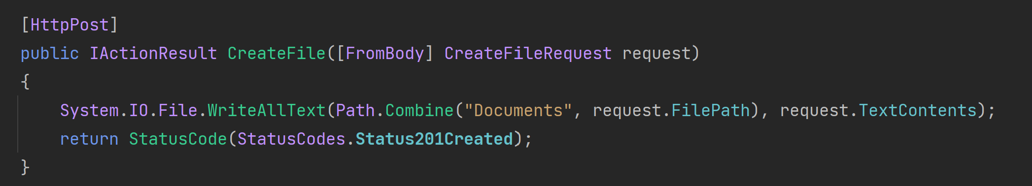
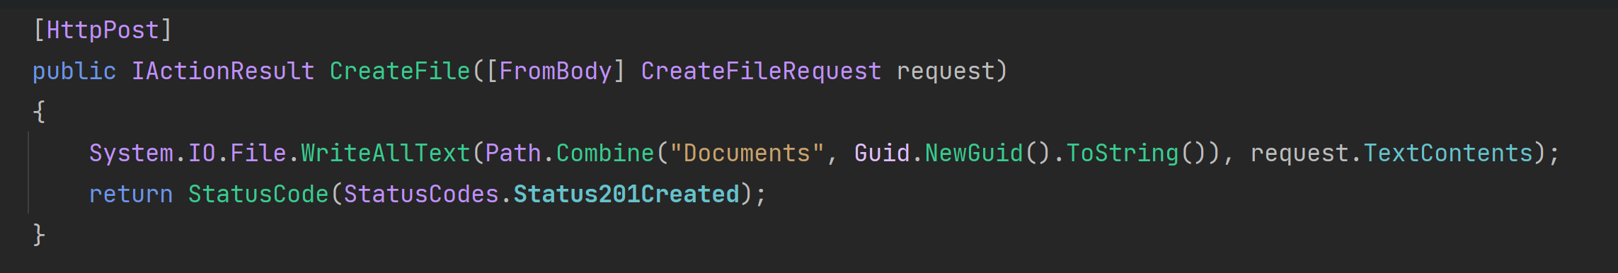
Vulnerable
Not Vulnerable

Slide 22
Directory Overwriting Demo

Slide 23
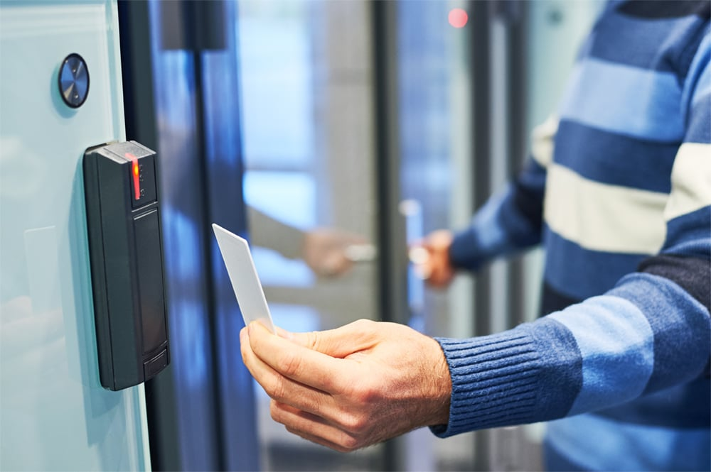
Broken Access Control

Slide 24
Broken Access Control
What is it?
Allows users to perform actions that should be outside of their control
Why should I care?
Non-Admin users could perform Admin actions like Editing or Deleting data or viewing sensitive data

Slide 25
Broken Access Control
How do I fix it?
Enforce correct permissions SERVER SIDE (not just client side)
Client-side is just UX so they don’t see things that aren’t relevant

Slide 26
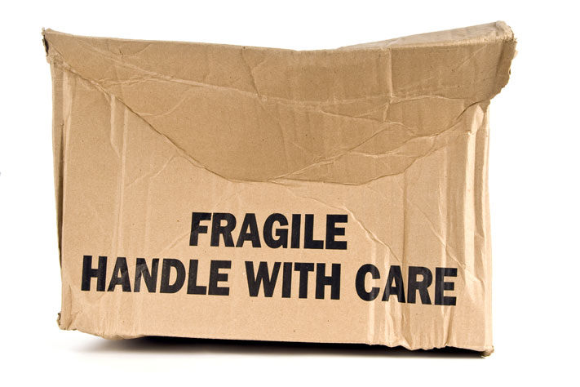
Package Vulnerabilities

Slide 27
Package Vulnerabilities
What is it?
Outdated and/or insecure packages
Why should I care?
Depending on how the package is used, this could be a catastrophic vulnerability in your application

Slide 28
Package Vulnerabilities
How do I fix it?
Stay up to date on latest versions
Use maintained/supported packages

Slide 29
Open SSF Scorecard
https://securityscorecards.dev/
Assesses open source packages for security risks
Code Vulnerabilities
Maintenance (Dependency Updating, Frequent History, License, etc)
Continuous Testing (Tests, SAST, Fuzzing)
Source Risk Assessment (Branch Protection, Code Review, etc.)
Build Risk Assessment (Signed Releases, Pinned Deps, etc)

Slide 30
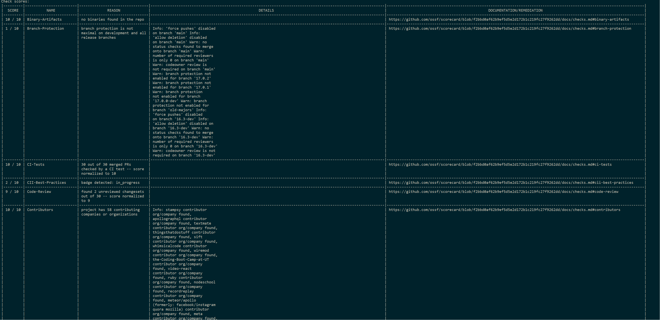
Open SSF Scorecard

Slide 31
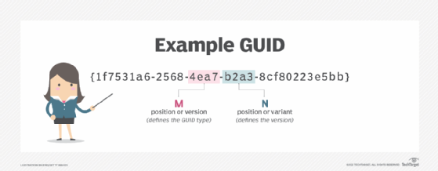
Using Ints instead of Guids

Slide 32
Using Ints instead of Guids
What is it?
Using auto-incrementing integers to to uniquely identify database rows
Why should I care?
Auto-incrementing ints can leak how much data is in the system (possible predictor of financials)
If Broken Access Control vulnerability exists, they can easily enumerate your data

Slide 33
Using Ints instead of Guids
How do I fix it?
Use random Guids instead of Ints for primary keys
Yes it comes at a performance penalty… but will you notice?
Or use it as a surrogate key

Slide 34

Container Image Vulnerabilities

Slide 35
Container Image Vulnerabilities
What is it?
Images provide an immutable artifact which is great for repeatability
The problem with immutable artifacts, is they don’t get updates
These images are used for deployments (i.e. Azure App Service/Container Apps, AWS ECS, etc)
Why should I care?
Depending on the vulnerability, your application may be partially or completely taken over

Slide 36
Container Image Vulnerabilities
How do I fix it?
Rebuild images regularly
Use a scanner
Use a PaaS service such as Azure App Service that auto-upgrades framework versions (i.e. .NET, Java, etc)

Slide 37
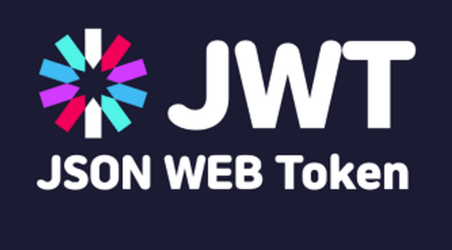
JWT Stale Roles

Slide 38
JWT Stale Roles
What is it?
Often times, web applications put role data in their JWT so they don’t have to go fetch it every time.
Why should I care?
The problem is, if a new permission is added or removed, the roles on the JWT will be stale
For example, if someone is terminated their JWT (and therefore access) might still be valid if you do local introspection

Slide 39
JWT Stale Roles
How do I fix it?
Round trip to get roles from the database every time
Performance or Security – pick one
Understand the tradeoffs

Slide 40
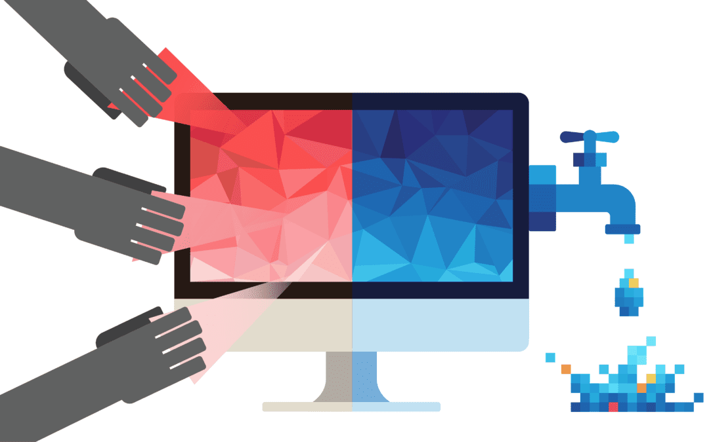
Data Leaking

Slide 41
Data Leaking
What is it?
Exposing too much data
Why should I care?
You could be exposing sensitive data to the wrong people

Slide 42
Data Leaking
How do I fix it?
Return back just the data you/your application/your customers need
Be wary of the spread operator in JS

Slide 43

Account Enumeration

Slide 44
Account Enumeration
What is it?
Exposing which users are registered for a system
Usually via Forgot Passwords or Create Accounts
Why should I care?
Leaks who your customers are, can be brute forced
Password leaks expose common passwords
Reuse of passwords from data breaches
https://haveibeenpwned.com

Slide 45
Account Enumeration
How do I fix it?
If someone does a Forgot Password don’t tell them a user doesn’t exist
Instead give them a message to check the email for the reset password link
And in the email tell them they don’t have an account
Similar model applies for creating new users

Slide 46
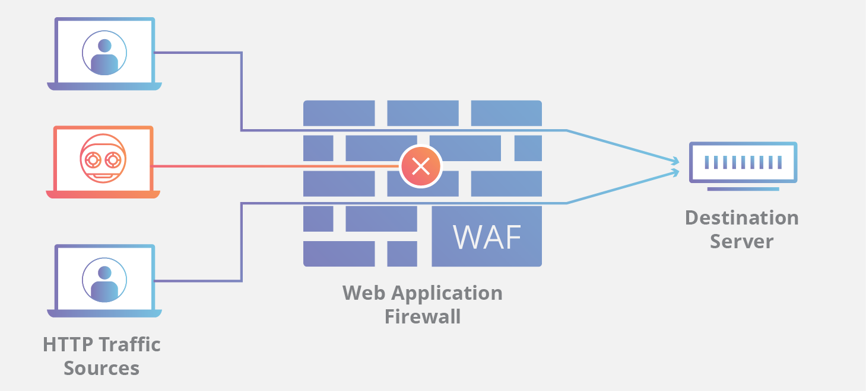
Lacking a WAF

Slide 47
Lacking a WAF
What is it?
Web Application Firewalls protect against many attacks (DDOS, scans, SQLi, etc)
Why should I care?
First line of defense against malicious attackers

Slide 48
Lacking a WAF
How do I fix it?
Purchase a WAF (i.e. Cloudflare, Imperva, Azure WAF, AWS WAF, etc)
Every web app should have a WAF
Usually gives you a free CDN too

Slide 49
Takeaways
Awareness different security vulnerabilities your web apps might have
More than just OWASP Top 10

Slide 50
Questions?

Slide 51
Thanks!

